Slide 1

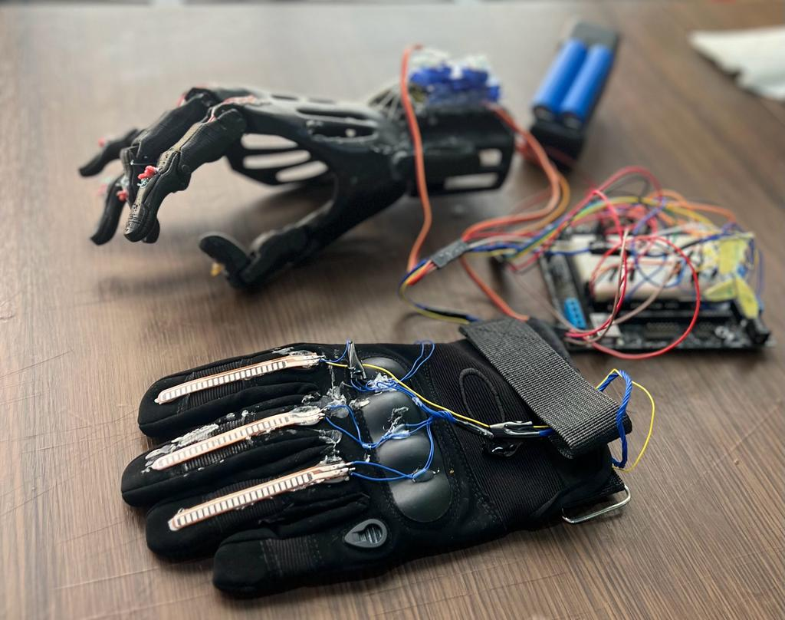
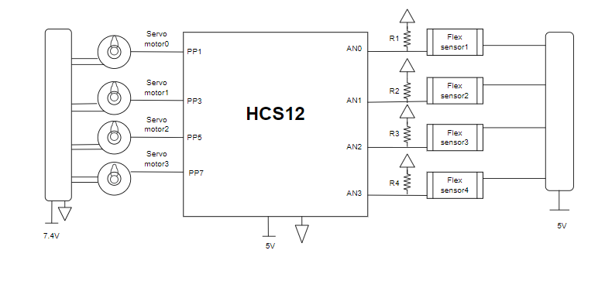
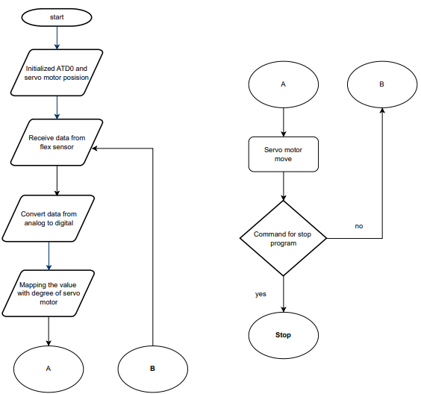
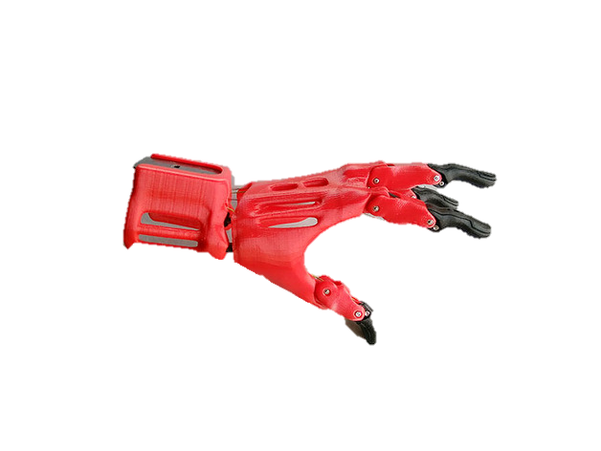
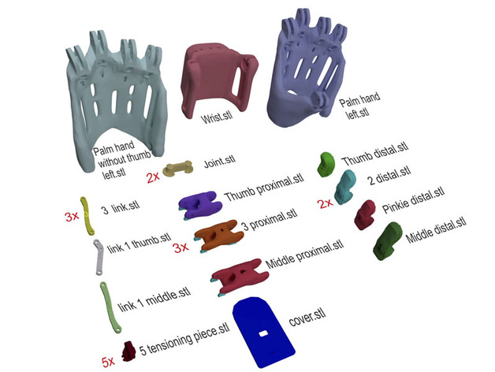
Robotic Hand Control System
R.Alshawawreh , H.Altahhan
Supervisor: Dr. Belal Sababha
Embedded Systems Design Final Design Project, Spring 2023
King Abdullah II School of Engineering
Princess Sumaya University for Technology
Introduction
This project presents the design and implementation of a robotic hand control system using the HCS12 microcontroller. The objective is to develop a robotic hand capable of mimicking human hand movements and performing gripping actions with precision. The HCS12 microcontroller serves as the central control unit, interfacing with motors, sensors, and a user interface. The control system incorporates motor control algorithms, sensor feedback, and a user-friendly interface to enable intuitive control of the robotic hand. The project involves hardware setup, motor control circuit design, sensor integration, algorithm development, and user interface design. Through this project, we aim to demonstrate the capabilities of the HCS12 microcontroller and explore its potential for controlling complex robotic systems.
Results
The result of this project is to control a multi servo motors using flex sensors via a HCS12 controller which results a precise control over the robotic hand fingers which could be scaled as per the requirements of the needed application.
Figure 4: Total Mechanical and Electrical Design
Flow chart
Figure 5: Flow chart
Design
This board was powered by two 3.7-volt batteries through a servo motor connected to the board. The HCS12 needs to convert the analog signal from the flex sensor to a digital value by connecting the sensor to the analog bins (ATD0-PINS (0.1.2.3)) and then sending the signal to the port p pins (1, 3, 5, 9) that are connected to the servo motor to pulsate a PWM signal that causes the motor to move.
Figure 1: Electrical Design
For mechanical design of the hardware part, we printed a 3D module in the university
Figure 2: 3D Printed Module Figure 3: 3D Printed Parts
.
Conclusion
The use of HCS12 microcontroller, along with the flex sensors and servo motors, allows for precise control over the robotic hand's movements. This opens up possibilities for more advanced applications, such as prosthetics or even space exploration. The future of robotics is bright, and the development of systems like this one will undoubtedly play a significant role in shaping it.
the design of a control system to operate a robotic hand using an HCS12 microcontroller holds great potential for enhancing the capabilities of robotic systems. The combination of the microcontroller's processing power, integrated peripherals, and software flexibility empowers us to create a control system that facilitates precise, coordinated, and intuitive control of the robotic hand. By leveraging the control system's capabilities, we can unlock new possibilities for robotics applications, ranging from industrial automation and prosthetics to assistive technologies and exploration in challenging environments.

